Slide 1
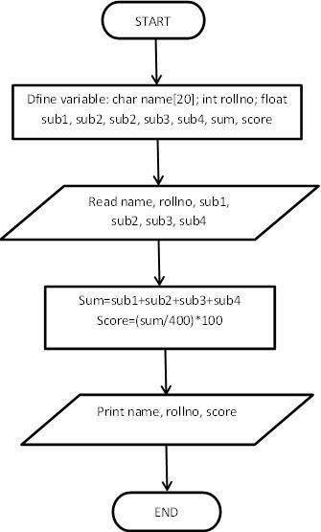
LAB : 2
Objective(s):
To be familiar with different data types, Operators and Expressions in C.
Program: Write a program to take input of name, rollno and marks obtained by a student in 4 subjects of 100 marks each and display the name, rollno with percentage score secured.
Algorithm:
Start
Define variables: name, rollno, sub1, sub2, sub3, sub4, sum, score
Take input from keyboard for all the input variables
Calculate the sum of marks of 4 subjects and also calculate the percentage score as:
sum = sub1 + sub2 + sub3 + sub4; score = (sum/400) * 100
Display the name, roll number and percentage score.
Stop
Flowchart:

Slide 2
Code: (Use comments wherever applicable)
//Following code is written and compiled in CodeBlocks #include<stdio.h>
#include<conio.h>
void main()
{
char name[20]; int rollno;
float sub1, sub2, sub3, sub4, , sum, score; printf("Enter name of student: "); scanf(“%s”,&name[]);
printf ("\n Enter Roll Number: "); scanf("%d", &rollno);
printf ("\n Enter Marks in 4 Subjects:\n"); scanf("%f%f%f%f", &sub1, &sub2, &sub3, &sub4); sum=sub1+sub2+sub3+sub4;
score = (sum/500)*100;
printf("\n Name of student: %s", name[]); printf("\n Roll Number: %d", rollno);
printf ("\nPercentage score secured: %2.2f%c", score,'%'); getch();
}
Output:
Enter name of student: Asif Roll Number: 25
Enter Marks in 4 Subjects:
50
75
85
62
Name of student: Asif
Roll Number: 25
Percentage score secured: 68.00%

Slide 3
SAMPLE PROGRAMS
(Students are to code the following programs in the lab and show the output to instructor/course Teacher)
Instructions
Write comment to make your programs readable.
Use descriptive variables in your programs(Name of the variables should show their purposes)
Programs List
Write a program to calculate simple and compound interest.
Write a program to swap values of two variables with and without using third variable.
Write a program to display the size of every data type using “sizeof” operator.
Write a program to illustrate the use of unary prefix and postfix increment and decrement operators.
Write a program to input two numbers and display the maximum number.
Write a program to find the largest of three numbers using ternary operators.
Write a program to find the roots of quadratic equation.
Take an integer input from the user. If the number is even, then divide it by 2, if the number is odd, then multiply by two and print the result. Result must be stored in “result” variable.

